Slide 1
UNIT-V
(Part-I)
Introduction To PL/SQL

Slide 2
Introduction
PL/SQL stands for Procedural Language/Structured Query Language, which is an extension of SQL.
The PL/SQL programming language was developed by Oracle Corporation in the late 1980s as procedural extension language for SQL.
It is the superset of the SQL.
Because it is procedural language, it removes many restrictions of SQL language.
With SQL, user can only manipulate the information stored in database.
PL/SQL extends SQL by adding control structures found in the other procedural languages.

Slide 3
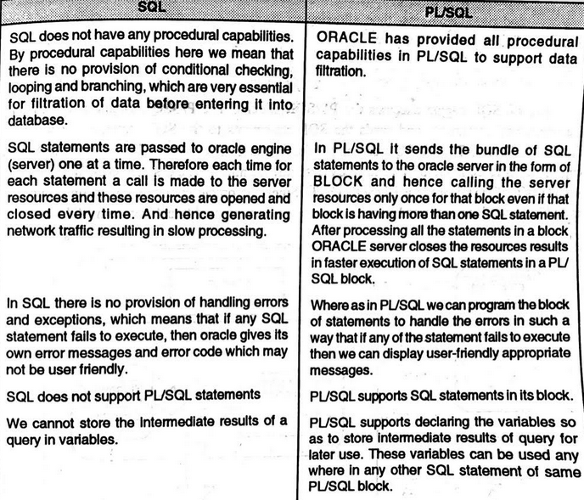
Difference between PL/SQL & SQL

Slide 4
Disadvantage of SQL
Don’t have procedural capabilities like condition checking, looping, and branching.
Can only manipulate the information stored into database.
To overcome the disadvantage of SQL, PL/SQL came into existence !!

Slide 5
Advantages of PL/SQL
PL/SQL is completely portable, high performance transaction processing language, which offers following advantages:
Supports declaration & manipulation of object types & collections.
Allows the calling of external functions and procedures.
Contains new libraries of built-in packages.
A package is a file that group functions, cursors, stored procedures & variables in one place.
Triggers: It is a program that is stored in the database and executed immediately before or after INSERT, UPDATE & DELETE.
Cursors: Oracle uses workspaces to execute SQL commands. Through PL/SQL cursors, it is possible to name the workspace and access the information.
PL/SQL allows us to manipulate values more effectively than SQL.

Slide 6
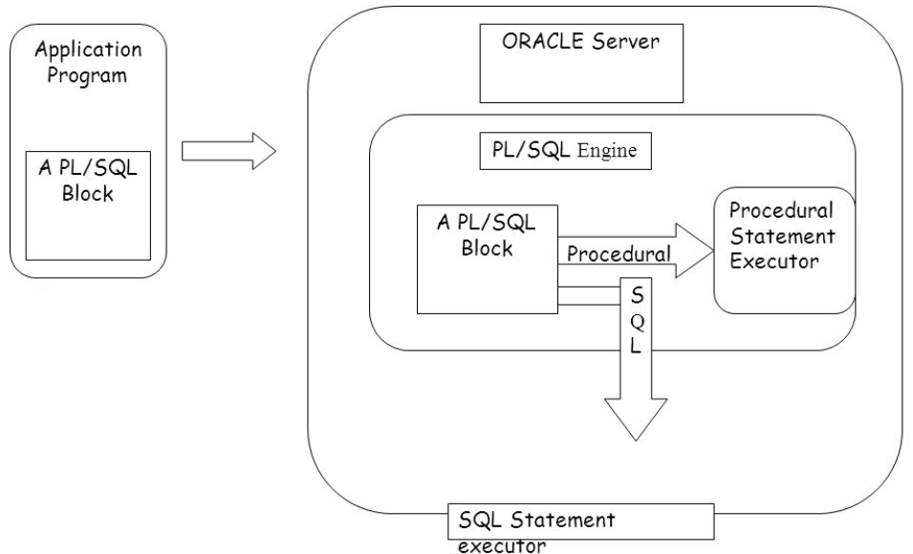
Architecture of PL/SQL execution

Slide 7
PL/SQL Engine executes PL/SQL Blocks, i.e. it executes only procedural statements and sends the SQL statements to the SQL statement executor in Oracle Server.
PL/SQL engine resides in Oracle Server. The call to Oracle engine needs to be made only once to execute any number of SQL Statements, if these SQL sentences are bundle inside a PL/SQL block.

Slide 8
Structure Of PL/SQL
Block is the smallest piece of PL/SQL code, which groups logically related declarations and statements.
Declarations are local to the blocks and cease to exist when block completes.
PL/SQL block consists of 3 sections:~
Declare
Used to declare variables & constants.
Is an option section.
Used to declare type declarations, PL/SQL procedures and functions which are local to module.
Begin
Executable section containing the code, which is executed when block is running
It is compulsory

Slide 9
Exception
Handles exceptions occurred during processing.
Used to place predefined error-handlers or user defined exceptions.
Code contained in this section is executed only when an error occurs.
Optional section.
PL/QSL is terminated with END and a semicolon(;).
Every PL/SQL block must have at least 1 block, which may contain any number of nested sub-blocks.
DECLARE (optional)
- variable declarations
BEGIN (required)
- SQL statements
- PL/SQL statements or sub-blocks
EXCEPTION (optional)
- actions to perform when errors occur
END; (required)

Slide 10
PL/SQL Language Elements
Character set
Operators, indicators and punctuation
Identifiers
Literals
Comments
Variables and constants
Data types & Declarations
Assignments
Expressions & Comparisons

Slide 11
Character set
Upper and lower case letters: A-Z, a-z
Numerals: 0-9
Symbols: ( ) , . < > ? / : ;’ “ { } [ ] !@#$%^&_+=-
Tabs and space
Data types
Number: integers and floating point number.
Char: alphanumeric up to 32767 bytes
Varchar: variable length alphanumeric
Date: date and time
Boolean: true, false or null

Slide 12
Declaration
Variable declaration
  variable-name datatype(size);
Constant declaration: A constant variable cannot be changed throughout the program.
  variable-name CONSTANT datatype(size) := value;
  Example:
  PI CONSTANT NUMBER := 3.14; -- constant declaration

Slide 13
PL/SQL Operators:
Arithmetic Operators
Operator | Description | Example(A=10, B=5)
+ | Adds two operands | A + B will give 15
- | Subtracts second operand from the first | A - B will give 5
* | Multiply both operands | A * B will give 50
/ | Divide numerator by de-numerator | A / B will give 2
** | Exponentiation operator, raises one operand to the power of other | A ** B will give 100000

Slide 14
Comparison Operators
Operator | Description | Example
= | Checks if the value of two operands is equal or not, if yes then condition becomes true. | (A = B) is not true.
!= <> ~= | Checks if the value of two operands is equal or not, if values are not equal then condition becomes true. | (A != B) is true.
> | Checks if the value of left operand is greater than the value of right operand, if yes then condition becomes true. | (A > B) is not true.
< | Checks if the value of left operand is less than the value of right operand, if yes then condition becomes true. | (A < B) is true.
>= | Checks if the value of left operand is greater than or equal to the value of right operand, if yes then condition becomes true. | (A >= B) is not true.
<= | Checks if the value of left operand is less than or equal to the value of right operand, if yes then condition becomes true. | (A <= B) is true.

Slide 15
Additional Comparison Operators
Operator | Description | Example
LIKE | The LIKE operator compares a character, string, or CLOB value to a pattern and returns TRUE if the value matches the pattern and FALSE if it does not. | If 'Zara Ali' like 'Z% A_i' returns a Boolean true, whereas, 'Nuha Ali' like 'Z% A_i' returns a Boolean false.
BETWEEN | The BETWEEN operator tests whether a value lies in a specified range. x BETWEEN a AND b means that x >= a and x <= b. | If x = 10 then, x between 5 and 20 returns true, x between 5 and 10 returns true, but x between 11 and 20 returns false.
IN | The IN operator tests set membership. x IN (set) means that x is equal to any member of set. | If x = 'm' then, x in ('a', 'b', 'c') returns boolean false but x in ('m', 'n', 'o') returns Boolean true.
IS NULL | The IS NULL operator returns the BOOLEAN value TRUE if its operand is NULL or FALSE if it is not NULL. Comparisons involving NULL values always yield NULL. | If x = 'm', then 'x is null' returns Boolean false.

Slide 16
Logical Operators
Operator | Description | Example
and | Called logical AND operator. If both the operands are true then condition becomes true. | (A and B) is false.
or | Called logical OR Operator. If any of the two operands is true then condition becomes true. | (A or B) is true.
not | Called logical NOT Operator. Used to reverse the logical state of its operand. If a condition is true then Logical NOT operator will make it false. | not (A and B) is true.

Slide 17
PL/SQL Literals
Literal Type | Example
Numeric Literals | 050 78 -14 0 +32767 6.6667 0.0 -12.0 3.14159 +7800.00 6E5 1.0E-8 3.14159e0 -1E38 -9.5e-3
Character Literals | 'A' '%' '9' ' ' 'z' '('
String Literals | 'Hello, world!' 'Tutorials Point' '19-NOV-12'
BOOLEAN Literals | TRUE, FALSE, and NULL.
Date and Time Literals | DATE '1978-12-25'; TIMESTAMP '2012-10-29 12:01:01';

Slide 18
PL/SQL Variable Types
Its a named variable which is used to hold some data value.
Syntax:
Variable-name datatype(size);
DECLARE
a number := 10;
b number := 20;
c number;

Slide 19
Assignment
Using assignment operator (:=)
      A := 10;
      Sum := A+B+C;
Get value from data base object. Using “SELECT INTO” clause
      Select salary into SAL from employee where empid=12;

Slide 20
PL/SQL is strongly typed
All variables must be declared before their use.
The assignment statement (:=) is NOT the same as the equality operator (=)
All statements end with a semi-colon (;)

Slide 21
PL/SQL Comments
Single line comment
  A := 5; -- assign value 5 to variable A.
Multi-line comments
  A := b + c; /* the value of variable A and B are added and assign to variable A */

Slide 22
Important PL/SQL delimiters
+, -, *, / arithmetic operators
; statement terminator
:= assignment operator
=> association operator
|| strings concatenation operator
. component indicator
% attribute operator
‘ character string delimiter
-- single line comment
/*, */ multi line comment delimiters
.. range operator
=, >, >=, <, <= relational operators
!=, ~=, ^=, <> not equal relational operators
is null, like, between PL/SQL relational operators

Slide 23
Displaying user message on the screen
DBMS_OUTPUT: A package that includes a number of procedure and functions that accumulate information in a buffer so that it cam be retrieved later. It is also used to display messages to the user.
PUT_LINE: It accepts a single parameter of character data type. If it is used to display a message, it is message ‘string’.
Example:
DBMS_OUTPUT.PUT_LINE(A);
DBMS_OUTPUT.PUT_LINE(‘Value of A is: ’ || A);
  || is concatenation operator
To display the message to the user, SERVEROUTPUT should be ON.
Syntax: Set Serveroutput [ON/OFF];

Slide 24
Read A Value During Runtime
Num := &num;
  This will produce a message on screen
    Enter the value of NUM:
    User can enter any value at run time to NUM.

Slide 25
Example Program: to display message
DECLARE
BEGIN
dbms_output.put_line(‘Welcome to DBMS’);
END;
/

Slide 26
To add two numbers
Declare
a number(2);
b number (2);
c number(2);
Begin
a:=5;
b:=2;
c:=a+b;
dbms_output.put_line(‘sum=‘ || c);
End;
/

Slide 27
To add two numbers
(get values from user)
Declare
a number(2);
b number (2);
c number(2);
Begin
a:=&a;
b:=&b;
c:=a+b;
dbms_output.put_line(‘sum=‘ || c);
End;
/

Slide 28
emp table
Emp_name | Emp_id | TA | DA | Total | Branch_City
abc | 10 | 1200 | 1345 | 2545 | Delhi
xyz | 12 | 1100 | 1200 | 2300 | Mumbai

Slide 29
PL/SQL code to calculate total amount(ta+da) of an employee, also update the emp table
Declare
a number(5);
b number(5);
t number(5);
Begin
select ta, da into a, b from emp where empid=12;
t:=a+b;
update emp set total =t where empid=12;
end;

Slide 30
Variable attributes
Attributes allow us to refer to data types & objects from the database.
There are 2 types of attributes:
%TYPE: Used when declaring variables that refer to databse columns. All you need to know is the column name and table to which variable will correspond.
Example:
DECLARE
Eno emp.empno%type --eno of same datatype & width as empno of emp table
Salary emp.sal%type
BEGIN
.............
END;

Slide 31
Advantages of using %TYPE :
Don’t need to know the exact data type of column empno and sal.
If the database definition of empno & sal is changed, then the datatype of empno & salary is changed accordingly at run time.
%ROWTYPE:
Provides a record type that represents a row in a table. One variable to access the complete row of the table.
Eg: Table EMPLOYEE have 4 columns- EMPID, LASTNAME, FIRSTNAME & SALARY- you want to manipulate the value in each column of row using only 1 referenced variable, the variable can be declared with %rowtype.

Slide 32
Example:
DECLARE
my_employee employee%ROWTYPE;
BEGIN
……………
END;
To refer empid of employee table, use my_employee.empid, similarly for lastname, use my_employee.lastname.
OTHER WAY:
DECLARE
my_empid employee.empid%TYPE;
my_lastname employee.lastname%TYPE;
my_firstname employee.firstname%TYPE;
my_salary employee.salary%TYPE;
BEGIN
………..
END;

Slide 33
Write a PL/SQL code to calculate total salary of employee having empno100. Table emp1 have columns:
empno, empname, bp, da, hra, total. Use %TYPE & %ROWTYPE for variable declaration.
DECLARE
B EMP1.BP%TYPE;
D EMP1.DA%TYPE;
H EMP1.HRA%TYPE;
T EMP1.TOTAL%TYPE;
BEGIN
Select BP, DA, HRA, into B,D,H from Emp1 WHERE Empno=100;
T = B+D+H;
UPDATE Emp1 SET Total = T WHERE Empno = 100;
END;
Emp_name | Emp_id | TA | DA | Total | Branch_City
abc | 10 | 1200 | 1345 | 2545 | Delhi
xyz | 12 | 1100 | 1200 | 2300 | Mumbai

Slide 34
With %ROWTYPE:
DECLARE
REC Emp1%ROWTYPE
BEGIN
Select * INTO REC from Emp WHERE Empno=100;
REC.Total = REC.BP + REC.DA + REC.HRA;
UPDATE Emp1 SET Total = REC.Total WHERE Empno = 100;
END;

Slide 35
Control statements
Conditional / selection control
It allows testing the truth of a condition & executing sections of programs depending on the condition that may be TRUE/FALSE.
Iterative control
It allows executing a section of program repeatedly as long as a specified condition remains TRUE.
Sequence control
It allows ordering the sequence of processing sections of programs.

Slide 36
Conditional Control
IF condition THEN
Sequence of statements;
END IF;
IF condition THEN
Sequence of statements;
ELSE
Sequence of statements;
End if;
IF condition1 THEN
  Sequence of statements;
ELSIF condition2 THEN
  Sequence of statements;
ELSE
  Sequence of statements;
END IF;

Slide 37
To find largest of 2 numbers
DECLARE
num1 number(2);
num2 number(2);
BEGIN
num1 := &num1;
num2 := &num2;
IF num1>num2 THEN
dbms_output.put_line(‘Greater number is =’ || num1);
ELSE
dbms_output.put_line(‘Greater number is = ’|| num2);
END IF;
END;

Slide 38
TRY YOURSELF!!
To find largest of three numbers(nested if)
To display the grade of students according to marks(elsif).
WAP to swap two numbers
      Using third variable.
      Without using third variable.

Slide 39
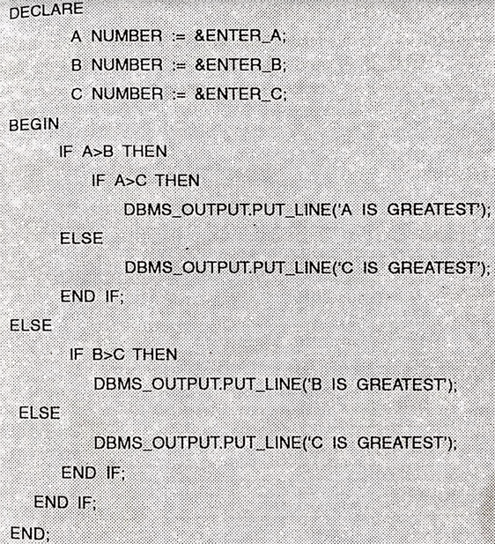
Using NESTED IF-ELSE, construct PL/SQL code to find greatest of 3 numbers.

Slide 40
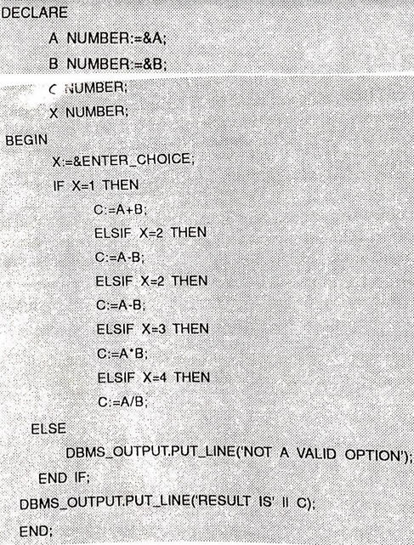
Using IF-THEN-ELSIF, calculate +, -, *, / of 2 numbers according to user’s choice.

Slide 41
Iterative Control
Sequence of statements can be executed number of times using LOOP.
The LOOPS can be classified as:
Simple Loop
While Loop
For Loop

Slide 42
Simple Loop
It’s the basic or infinite loops, which encloses statements as:
LOOP
Sequence of statements;
END LOOP;
If processing is not required, you can use EXIT statement to complete the loop.
There are 2 forms of EXIT:
EXIT
  Forces loop to complete unconditionally.
Exit when
  To exit on condition

Slide 43
To print numbers 1 to 10
DECLARE
i number(2);
BEGIN
i:=1;
LOOP
dbms_output.put_line(i);
i := i+1;
EXIT WHEN i>10;
END LOOP;
END;
/

Slide 44
WHILE LOOP
Statements are executed when condition is TRUE.
WHILE loop associates a condition with a sequence of statements enclosed by the keywords LOOP & END LOOP.
SYNTAX:
WHILE condition
LOOP
Sequence of statements;
updation;
END LOOP;

Slide 45
To print Square of number from 1 to 10
Declare
a number(2);
Begin
a:=1;
WHILE a<=10
LOOP
Dbms_output.put_line(a*a);
a:=a+1; --updation
END LOOP;
End;
/

Slide 46
To print multiplication table
DECLARE
n NUMBER:= :ENTER_TABLE_OF;
i NUMBER:= 1;
res NUMBER;
BEGIN
DBMS_OUTPUT.PUT_LINE('Table of '|| n);
WHILE i<= 10
LOOP
res := n * i;
DBMS_OUTPUT.PUT_LINE(n ||'*'|| i ||'='|| res);
i := i+1;
END LOOP;
END;

Slide 47
For loop
FOR loop iterate over a specified range of integers. The range is a part of iteration scheme which is enclosed by FOR & LOOP.
A double dot(..) serves as range operator.
SYNTAX:
FOR counter IN [REVERSE] lower bound..higher bound
LOOP
Sequence of statements;
END LOOP;

Slide 48
Declare
total number(4);
i number(2);
Begin
FOR i in 1..10
LOOP
total := 2*i;
Dbms_output.put_line(‘2*’||i||’=‘||total);
END LOOP;
End;

Slide 49
Reverse FOR loop
FOR i IN REVERSE 1..10
Loop
Dbms_output.put_line(i); -- prints 10 to 1
End loop

Slide 50
To calculate the factorial of given number
Declare
num number(2);
i number(2);
fact number(4);
Begin
fact := 1;
num := :num;
For i in 1..num
Loop
fact := fact * i;
End loop;
Dbms_output.put_line(fact);
End;

Slide 51
Sequence control
GOTO and NULL are commonly used to change the sequence of statements
GOTO STATEMENT
Branches to a label unconditionally.
When executed, GOTO transfers the control to the labeled statement or block.
Syntax:
BEGIN
……
GOTO insert_row;
<<insert_row>>
………
END;

Slide 52
GOTO EXAMPLE
Declare
num1 number(2);
Num2 number(2);
Begin
num1:=&num1;
num2:=&num2;
If num1> num2 then
Goto p1;
Else
Goto p2;
End if;
<<p1>>
Dbms_output.put_line(‘num1 is bigger’);
goto p3;
<<p2>>
Dbms_output.put_line(‘num2 is bigger’);
<<p3>>
NULL;
End;
NULL STATEMENT:
It specifies inaction, i.e. it does nothing other than passing control to next statement.

